Slide 1

Data Science 106
Machine Learning - Neural Nets

Slide 2
Schedule
 | Title | Description | Exercise
1 | Python 101 | Intro to syntax and core concepts | Python workbook
2 | Data Analysis | Analysis libraries (numpy and pandas) | CO2 Analysis
3 | Databases | DB storage and SQL | Build own database
4 | Visualisation | Sexy graphs, charts, and wordclouds | Colourful visualisation
5 | Machine Learning | Simple models | Regression & Decision Trees
6 | Machine Learning | Complex models - Neural Networks | Visual recognition
7 | Watson Integration | Integrating with Watson cloud services | Watson labs

Slide 3
Outline
Complex Models
Neural Network Basics
Demo of 2 Pre-Trained

Slide 4
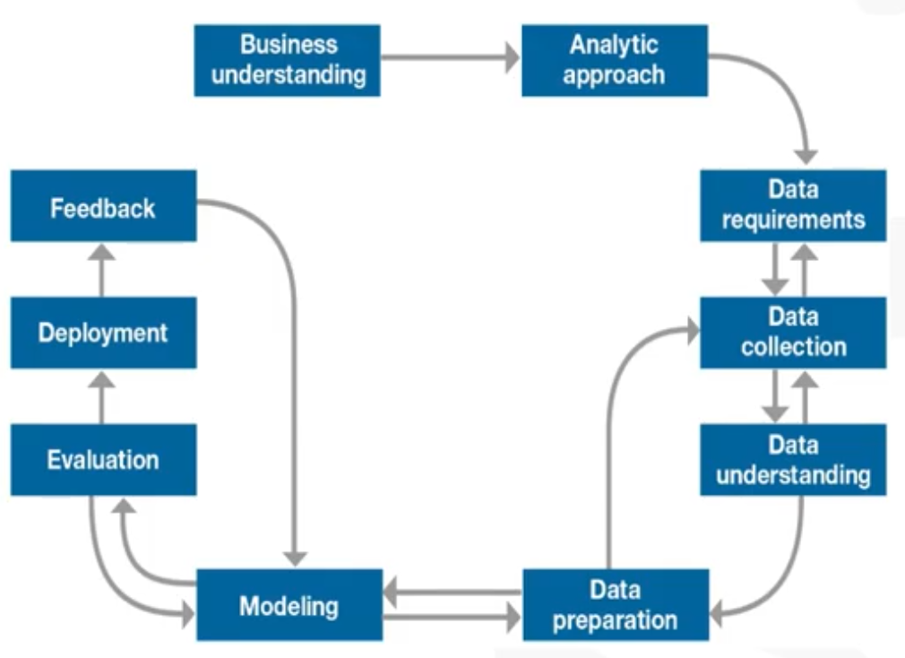
The latter stages of our DS Journey

Slide 5
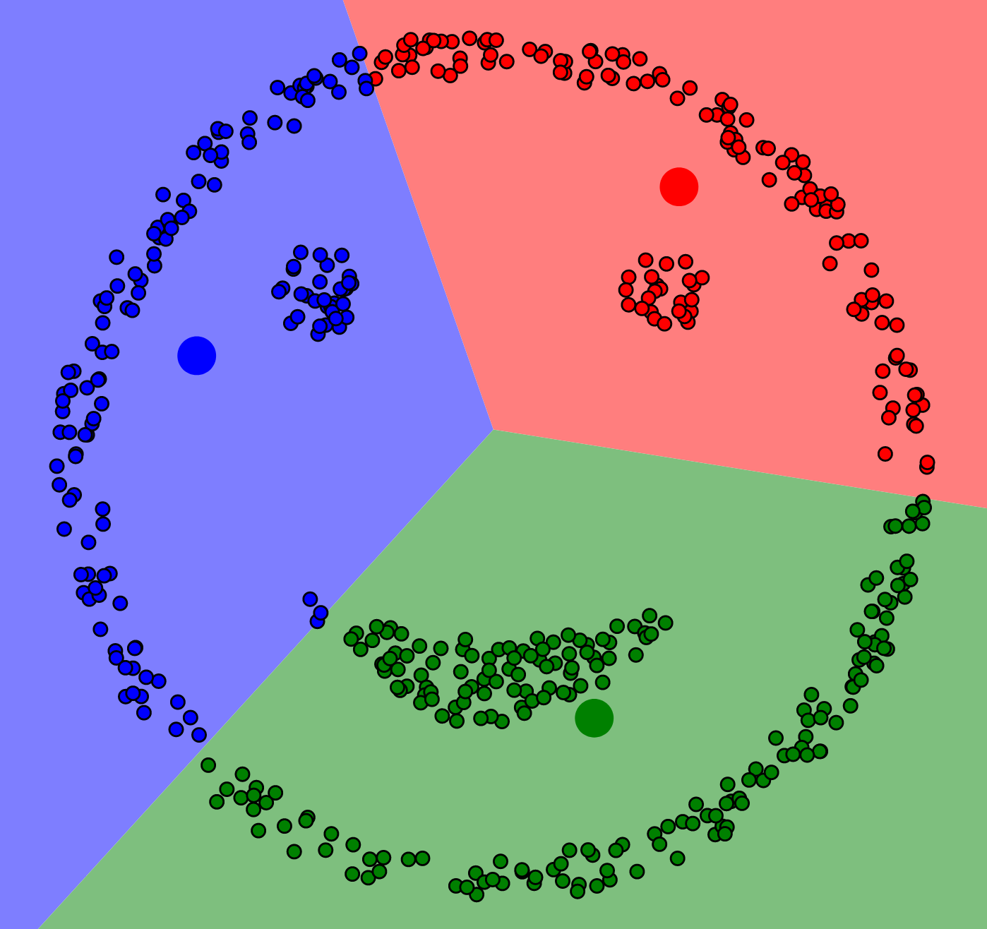
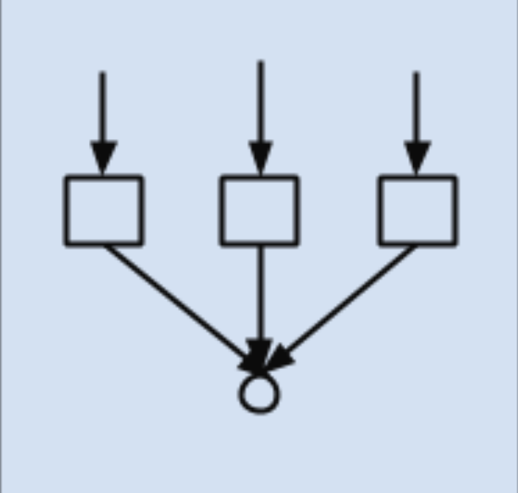
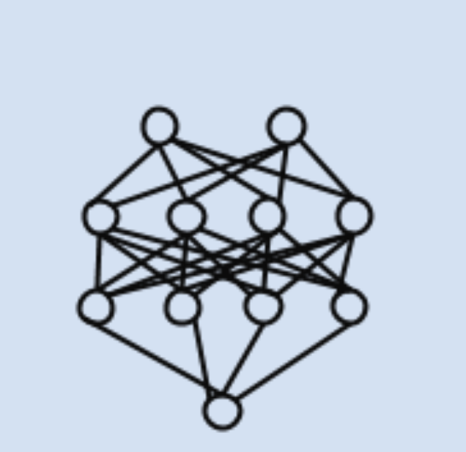
Complex Models
NOT a specific term
NOT inherently better
Different ways of producing output predictions
Typically unsupervised methods or reinforcement learning
Clustering
Ensemble methods
Neural Networks
Reinforcement Learning
Notes:
Depends on data, business needs, and output type
e.g. Decision Trees for simple data and clear explanations
Linear Regression models

Slide 6

Basic Neural Network Theory
Made up of layers of neurons: a holder of a number
Neurons are activated if their values pass a test (e.g. are above a certain number)
Activated neurons pass weights to multiple neurons in the next layer
New neurons are fed multiple weights and aggregate them
New neurons are activated if the aggregated value passes a test
Repeat until final layer of classifications
Neural Networks evaluate performance against validation data
Reiterate the steps above to refine activation thresholds and weights
Check out this excellent intro from 3Blue1Brown a great Data Science youtuber

Slide 7
Walkthrough of Pre-Trained Neural Nets
Keras deep learning models with pre-trained weights
We’ll be using 2 visual recognition models
InceptionResNet
VGG19
Prerequisite files in box
Download the ‘Pre-Trained Neural Network-Template’ notebook
Run it. Downloading the pre-trained models can take up to 30 minutes
Download and unzip our test ‘Keras-Images’ to the same folder

Slide 8
Let’s get doing

